Slide 1
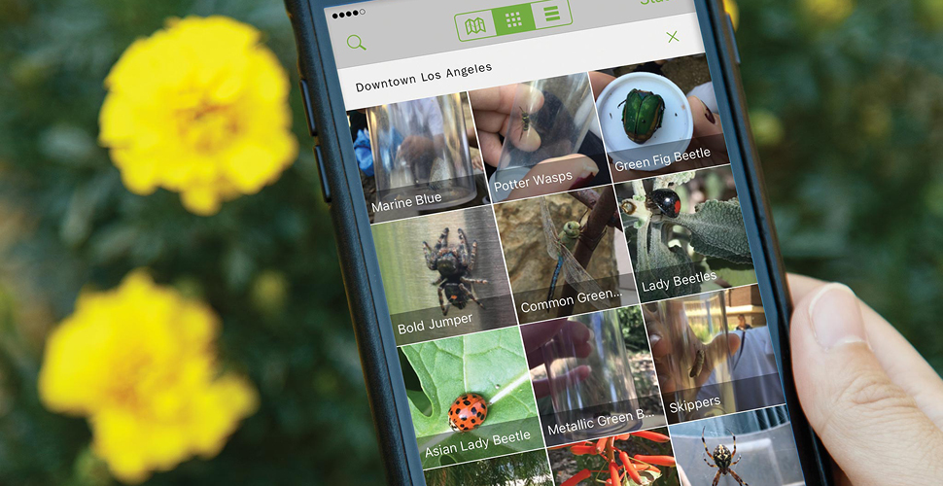
iNaturalist Training
Notes:
Feel free to adapt this training for your own purposes. If you use and/or adapt this training please just give recognition to the original creator Richard Smart from Natural History Museum of Los Angeles County.
Any questions you have about specific slides etc please contact rsmart@nhm.org

Slide 2
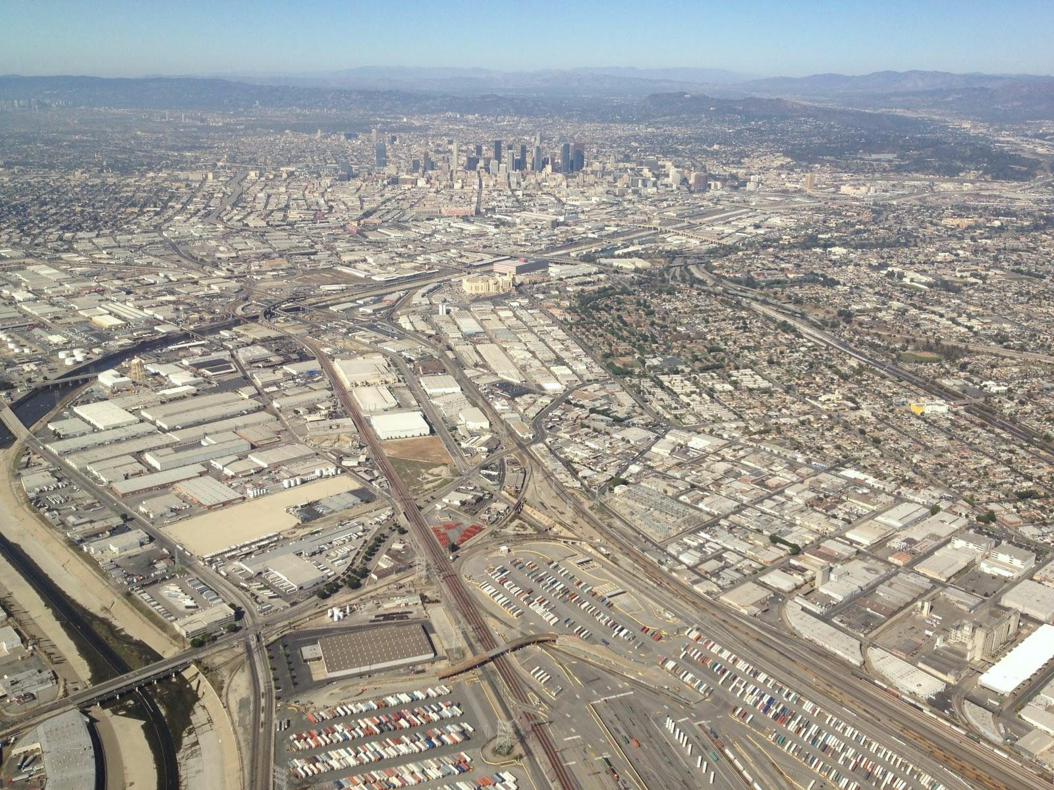
What is Citizen Science
Projects in which volunteers partner with scientists to answer real-world questions.
- Cornell Laboratory of Ornithology

Slide 3
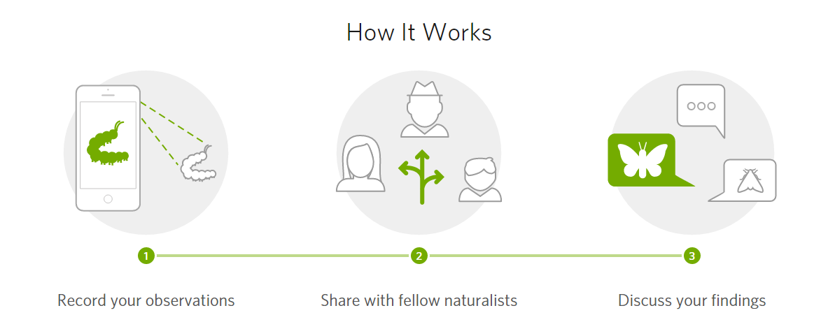
iNaturalist
Social network for naturalists and scientists.
Notes:
iNaturalist is an online social network of people sharing biodiversity information to help each other learn about nature

Slide 4
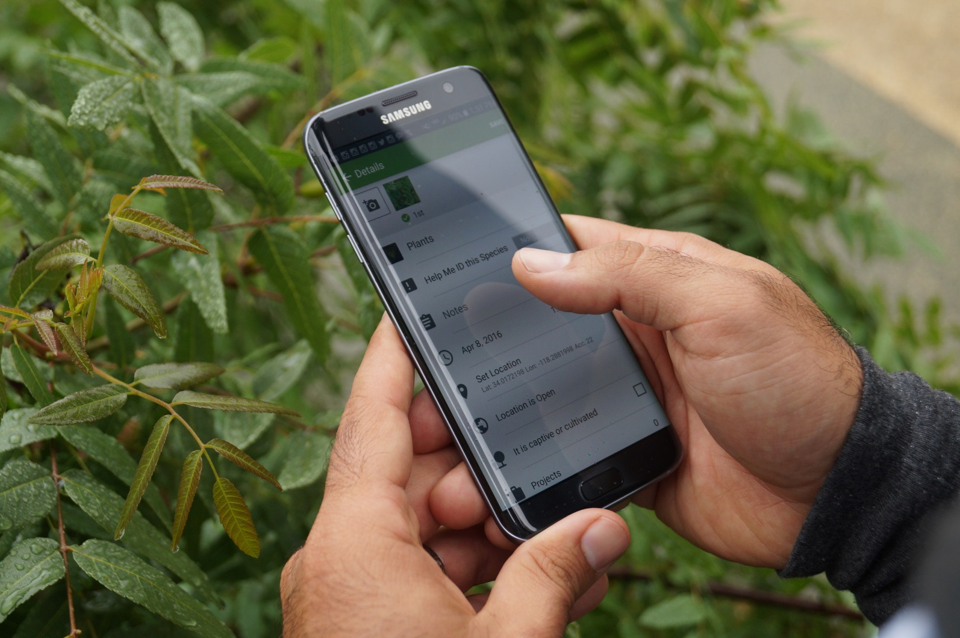
iNaturalist Mobile App
Notes:
Here – use the dongle to show the iNaturalist mobile app – join projects, demo features, then practice. Come back inside to show remaining slides.

Slide 5
What is a bioblitz?
A bioblitz is an event that focuses on finding and identifying as many species as possible in a specific area over a limited period of time.

Slide 6
Pro Tips
Capture the moment
Focus
Different angles
Know your camera
Looking for wildlife
Safety

Slide 7
Capture the Moment

Slide 8
Capture the Moment

Slide 9
Capture the Moment

Slide 10
Capture the Moment

Slide 11
Capture the Moment

Slide 12
Capture the Moment

Slide 13
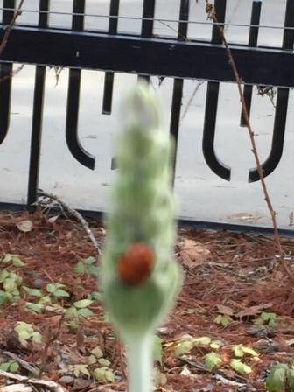
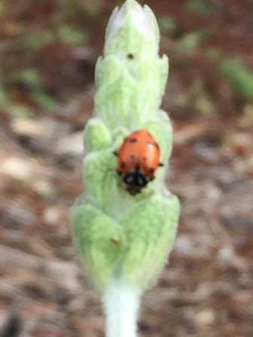
Focus

Slide 14
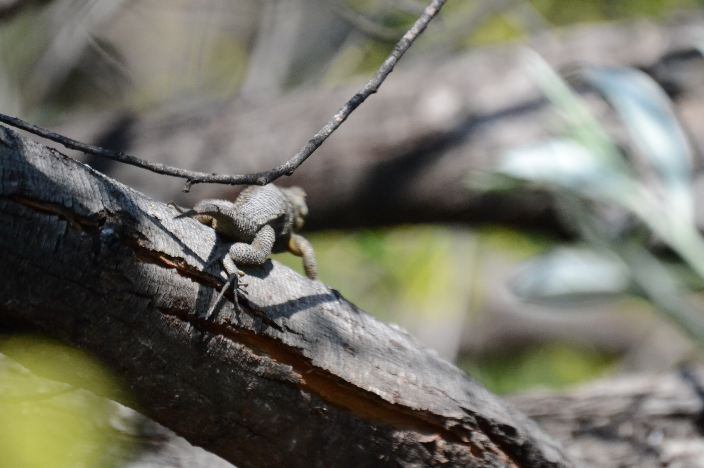
Focus

Slide 15
Take photos of different angles

Slide 16
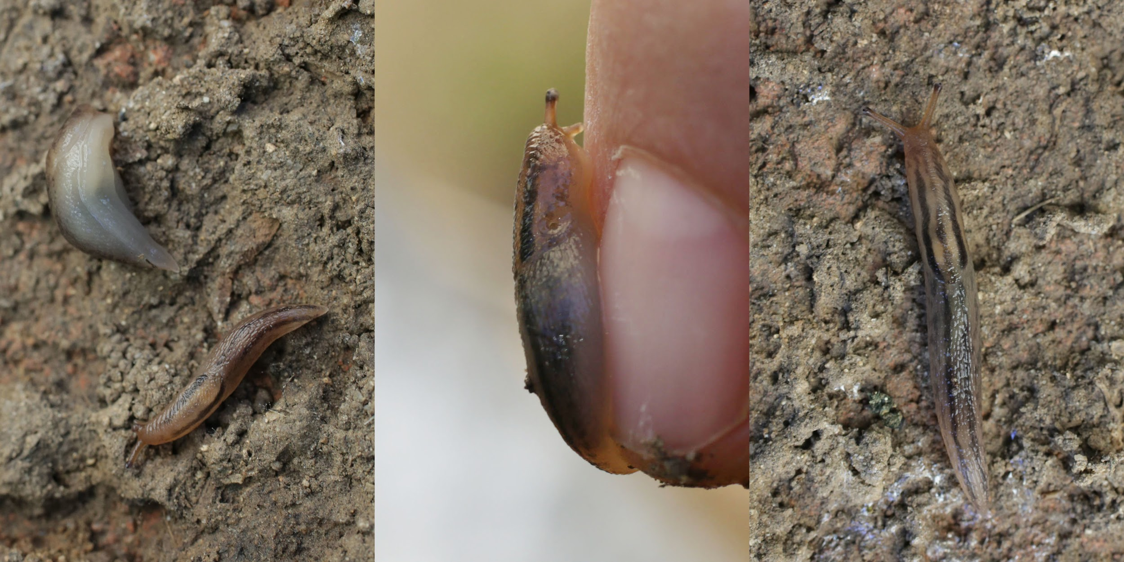
Take photos of different angles

Slide 17
How to look for wildlife
Find habitat
Sources of food, water, shelter
Look up
Some animals fly and climb trees
Look down
Some animals spend most of their time on the ground or underground

Slide 18
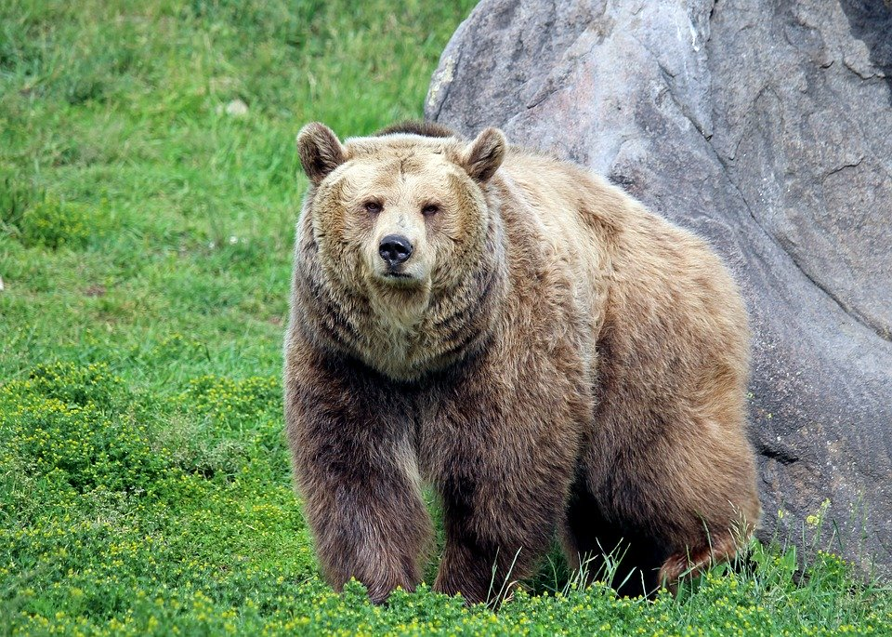
Safety First!

Slide 19
BioBlitz
BioBlitz until end of semester, add from phone when you are out
Each person needs to enter observations
May work individually or in (socially distanced) groups

Slide 20
Organisms to include:
Wild animals (including slugs, insects, spiders, birds, mammals, snakes, etc.), plants, fungi, etc.
DON’T INCLUDE: plantings, crops, pets, zoo animals, farm animals, non-living things (e.g. rocks)

Slide 21
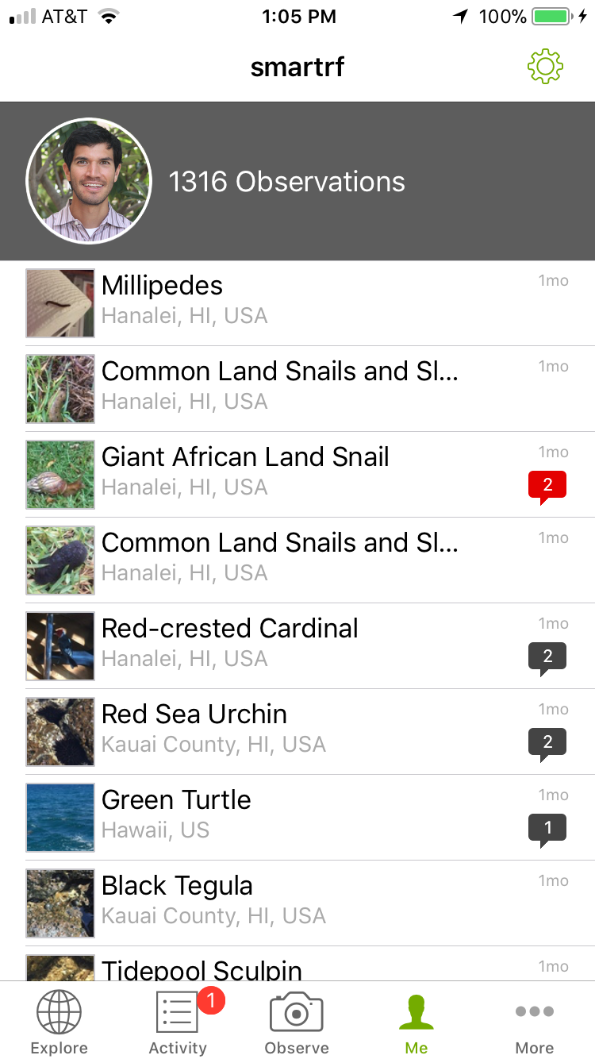
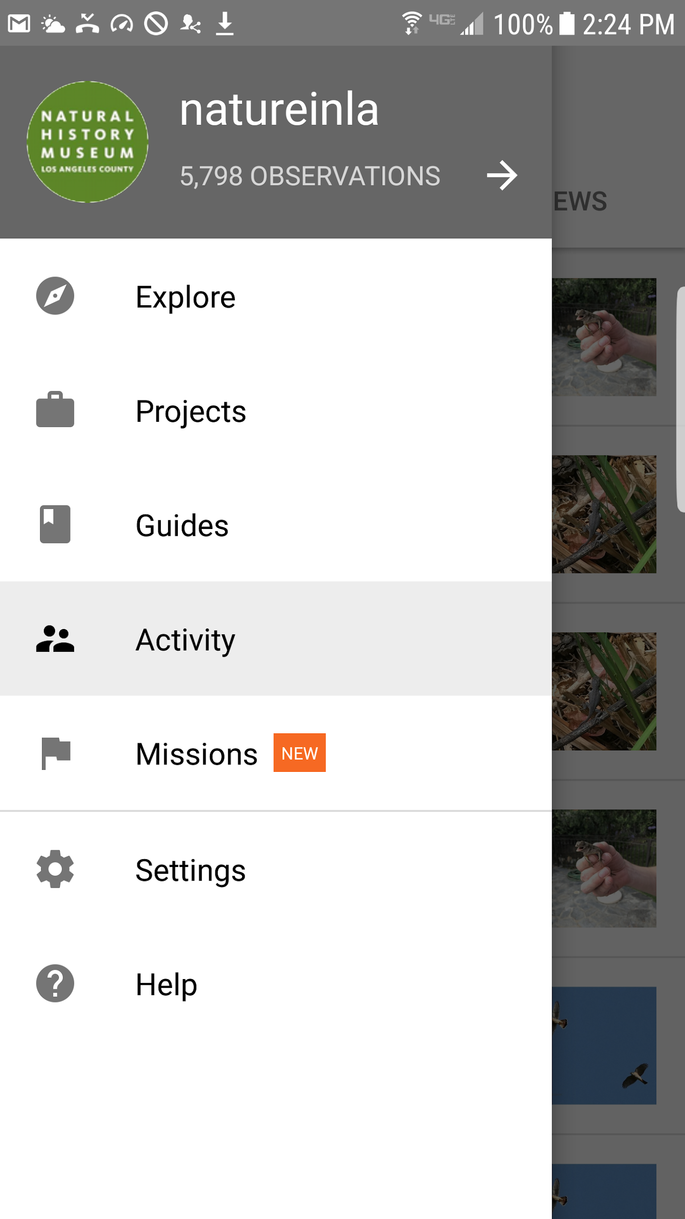
Notifications/Activity

Slide 22
iNaturalist website – inaturalist.org
Uploading observations
Add to project
Check activity (other people/scientists will add identification information, correct or corroborate one another)

Slide 23
Creating an iNaturalist project
Why create an iNaturalist project?
A call to action
Collect additional data
Learn about biodiversity
Use AI and scientist help with identifications so you can do online research on target organisms
Become more familiar with local organisms

